Slide 1
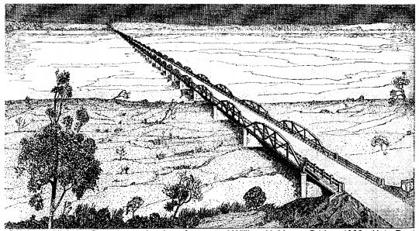
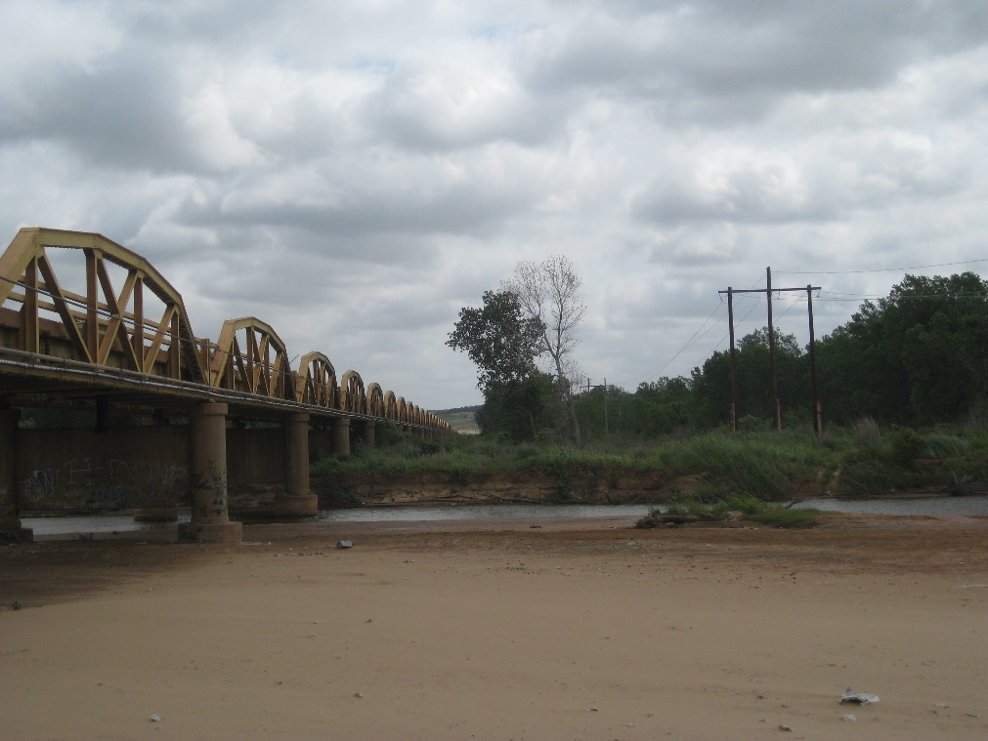
Consulting Party Meeting US-281 Bridgeport Bridge over the South Canadian River July 9, 2020

Slide 2
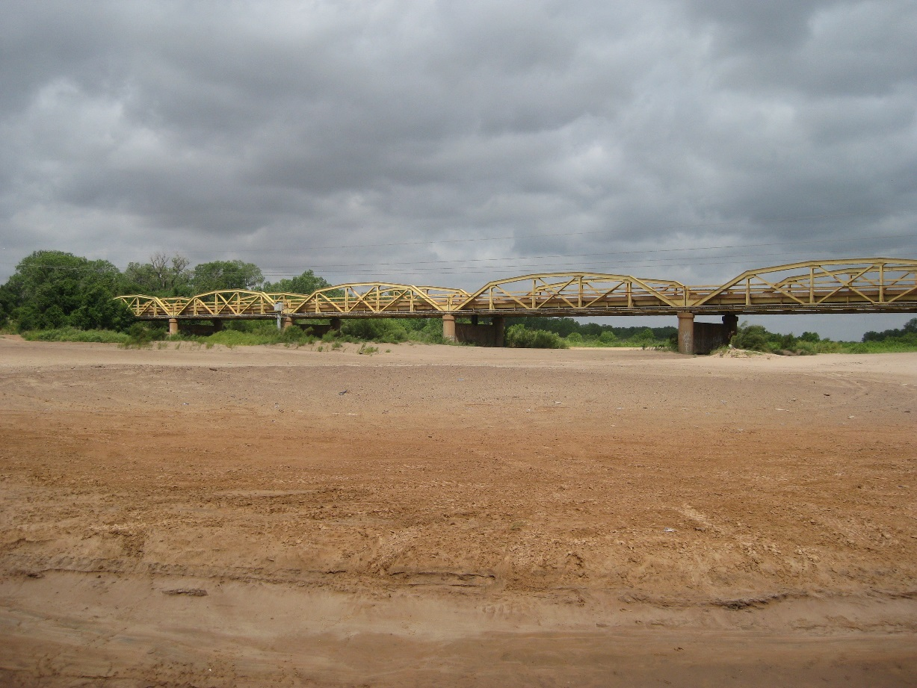
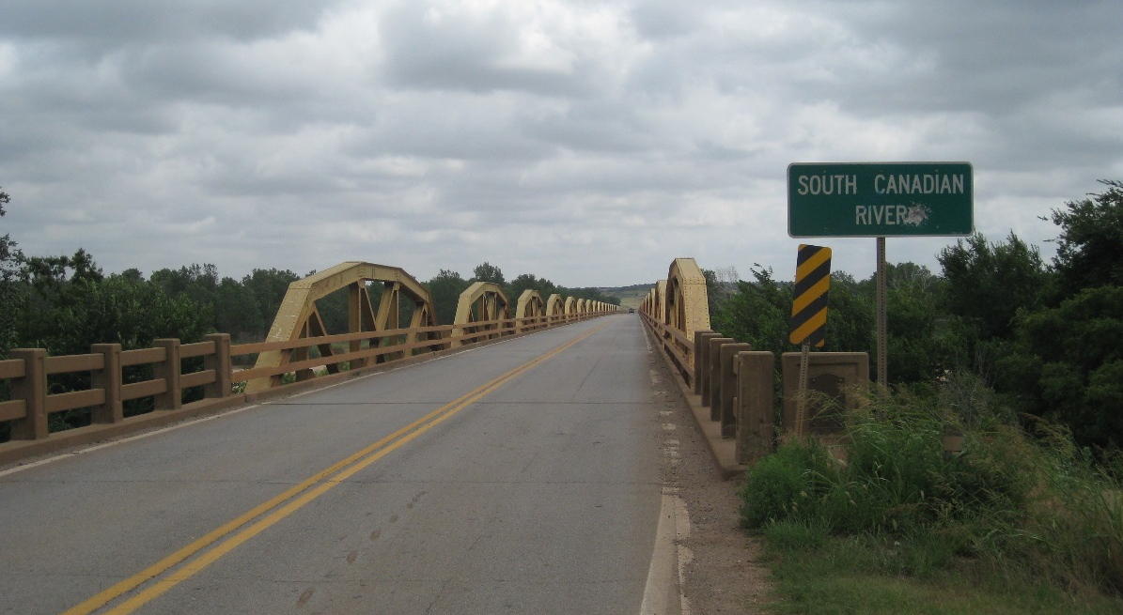
US-281 Bridgeport Bridge

Slide 3
US-281 Bridge over South Canadian River:
Also known as:
The Bridgeport Bridge (most common: how we will refer to it)
The Grapes of Wrath Bridge
The William H. Murray Bridge
The Pony Bridge
Constructed in 1932-1933, put into use in 1934
38-Span Camelback Pony Truss Bridge, 2nd Longest Bridge still in existence in Oklahoma
A contributing feature of the NRHP-listed 17.7-mile-long Bridgeport Hill-Hydro Route 66 Segment Historic District AND is individually eligible
District was initially listed for its local significance, but is currently being considered for its national significance
Arguably the most historically significant bridge still standing in Oklahoma

Slide 4
Project History
Draft Cultural Resources Reconnaissance Report (Summer 2015)
Draft Design Alternatives Report (Spring 2016)
Field Meeting (Spring 2016)
Section 106 Consulting Party Meeting (Summer 2016)
Project Suspended/Closed (January 2018)
Application Attempt for BUILD Grant (Summer 2019)
ODOT-CRP Completed Cultural Resources Study: No new historic properties (SHPO Concurrence, Fall 2019)
BUILD Grant Application Submitted (May 18, 2020)
Re-Application for BUILD Grant (application due July 25, 2020)
Proposed Project Letting (November 2021)
Route 66 Centennial (2026)
Notes:
Point out BUILD grant and indicate “More on that later!”

Slide 5
The need for the project is as follows:
The existing Bridgeport bridge is structurally deficient.
Lack of redundancy in elements means a single component failure could cause entire span to fail (Fracture Critical)
The bridge is load-posted but heavy trucks continue to use it, seriously threatening its ability to withstand the loads.
The existing bridge is of substandard width and does not comply with current American Association of State Highway and Transportation Officials (AASHTO) minimum values.
The Bridgeport Bridge and adjacent roadway segments are iconic, historic features of Route 66, integral to the regional tourism economy.
The purpose of this project is as follows:
Provide a bridge crossing that is structurally sufficient for its intended use.
Preserve Route 66 as a tourist destination in Oklahoma.

Slide 6
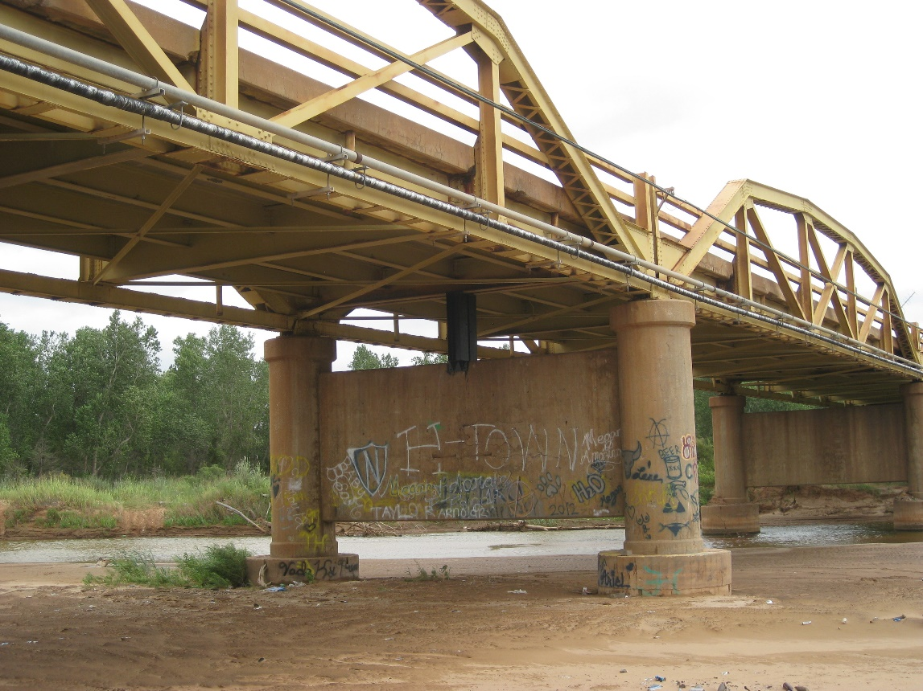
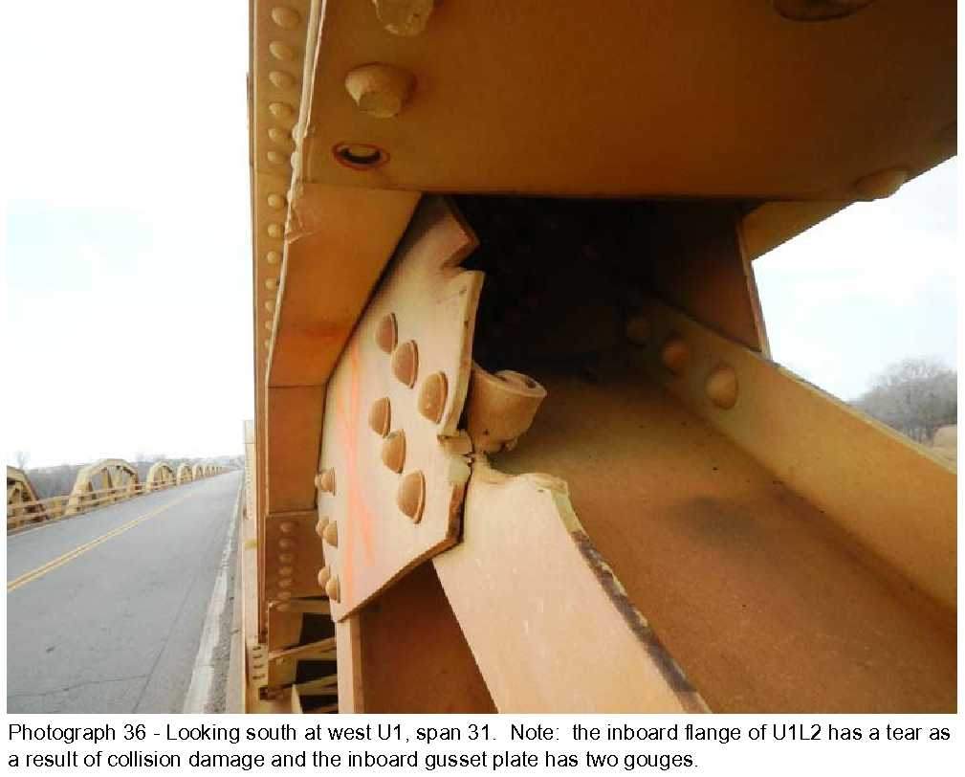
Bridge is Structurally Deficient
Condition Ratings (2018)
Deck = 5 (Fair)
Superstructure = 4 (Poor)
Substructure = 5 (Fair)
Load Posted (15-ton Limit lowered to 9-ton)
2019: ODOT indicated that even with ongoing maintenance and repairs, the bridge will have to be closed to ALL traffic within 18 months
DECK
SUPERSTR.
SUBSTR.

Slide 7
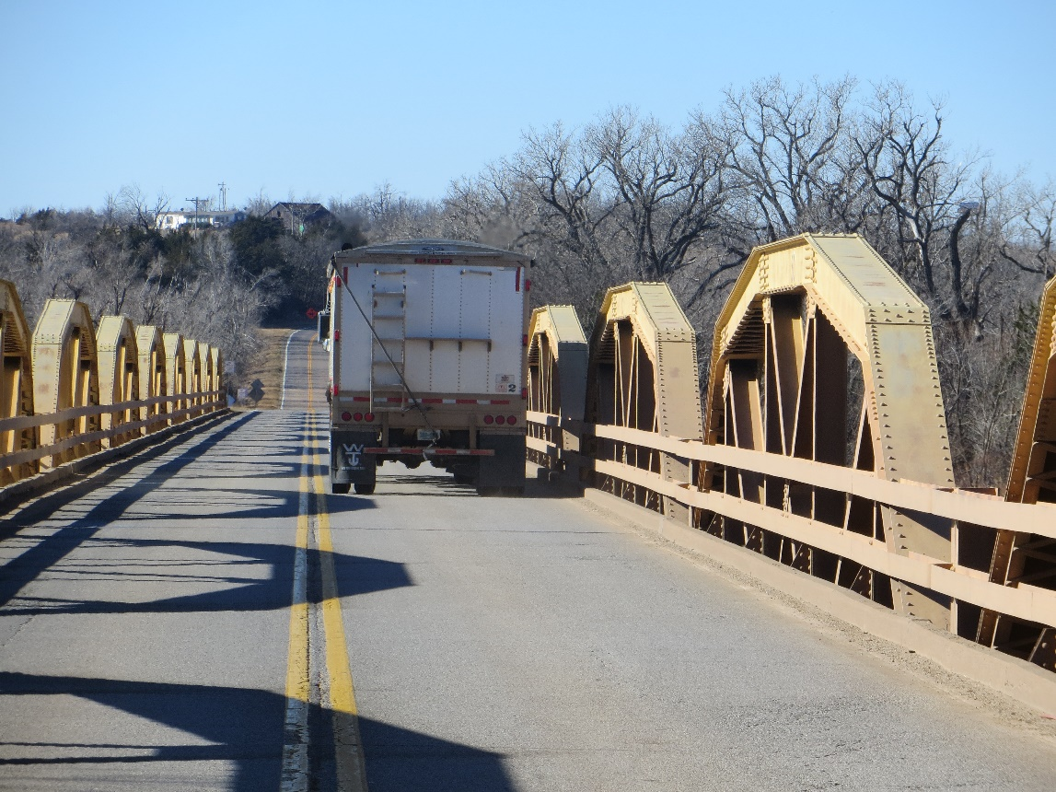
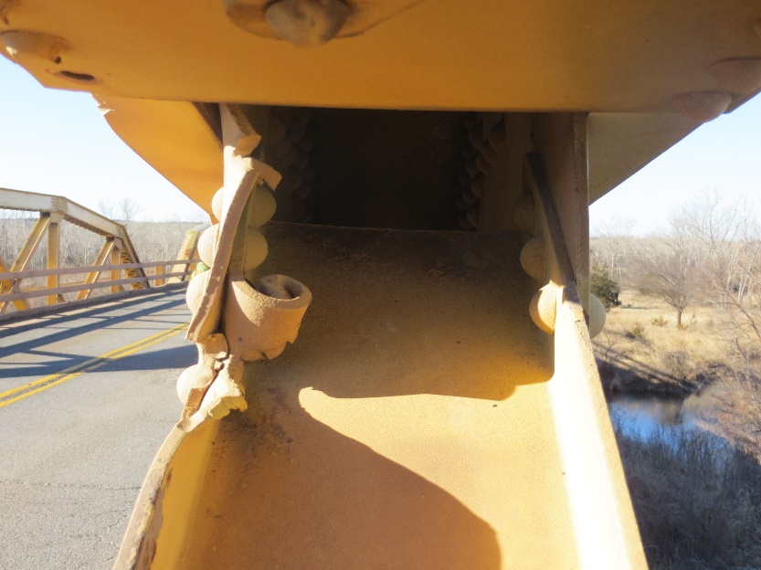
Bridge is Too Narrow
Functionally Obsolete
Existing 24 ft. Roadway
(2018) 2,600 Vehicles Per Day
21% Trucks
2060 Projected Vehicles Per Day: 5,900
Rural Minor Arterial
AASHTO Guidelines: 36 ft. Minimum Roadway
Bridge truss members frequently struck by trucks, causing additional structural damage
Example of damage to truss member
Notes:
Add caption for truss member

Slide 8
Existing Roadway and Bridge
24’-0” CLEAR ROADWAY
12’-0” LANE
12’-0” LANE
HISTORIC TRUSS MEMBER
EXISTING CONCRETE PIER
EXISTING ROADWAY

Slide 9
Previous Proposed Alternatives

Slide 10
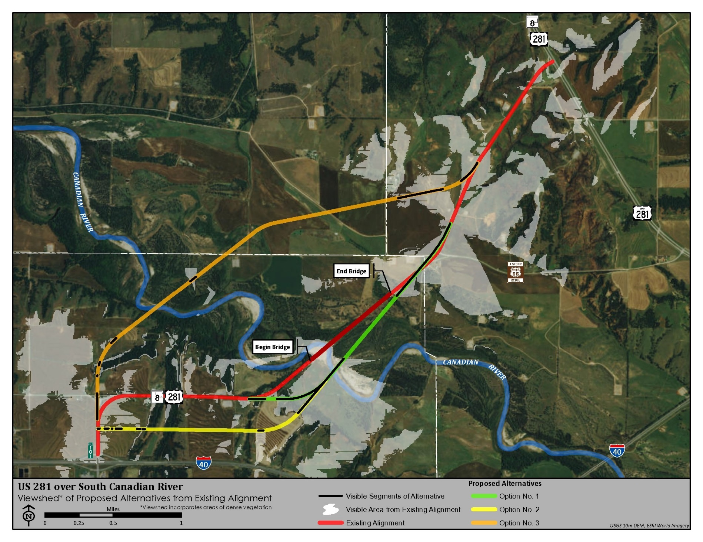
Viewshed Aerial Map
Notes:
Previously (2015) this was the technology we had available to consider the visual impact of new structures to the bridge. Now, we have much better capabilities and have 3D renderings for you, for the newest proposed alternative

Slide 11
Alternatives Chart
US 281 over South Canadian River – Bridgeport Bridge
Alternative A
No Build
Alternative B
Rehabilitation
Alternative C
New Bridge
Alternative D
Monument
$0
Full Traffic at Existing Width
Load-Posted
Owned and
Maintained by ODOT
Owned and Maintained by Others
$35,210,000
$18,555,000
$18,774,000
$9,784,000
Option 1
South Offset, Tie to
Existing Alignment
Option 2
South Offset with New Alignment
Option 3
North Offset with
New Alignment
Option 4
Reconstruct on
Existing Alignment
$38,130,000
Load-Posted
Pedestrian and Bicycle
Load-Posted
Pedestrian and Bicycle
Load-Posted
Pedestrian and Bicycle
Costs updated for July 2021 Construction Letting
$58,101,000
$48,756,000
$58,102,000
$48,757,000
$62,049,000
$52,704,000
Notes:
Point out that the figures are SO for rehab because of so many parts on an extremely long bridge

Slide 12
Alternatives
Previous alternatives focused mainly on keeping bridge in place or using in-kind materials for rehabilitation, or an entirely new alignment
Rehabilitation might still be an adverse effect to the bridge due to the high level of deterioration of all elements
ODOT does not have the funding for the extensive work that would be required for rehabilitation or a new alignment of the roadway
Rehabilitation to Secretary of the Interior (SOI) Standards would only extend bridge design life by 15 years, at which time structural condition would again need to be addressed

Slide 13
BUILD Grant Application Process
What is it?
USDOT Better Utilizing Investments to Leverage Development (BUILD) Grant
This grant “…provides a unique opportunity for the DOT to invest in road, rail, transit and port projects that promise to achieve national objectives…to fund projects that have a significant local or regional impact”.

Slide 14
BUILD Grant Application Process
To apply, ODOT was required to submit a single project and single alternative for review by the selection committee (application submitted May 18, 2020)
The alternative submitted is strictly for purpose of the grant application and DOES NOT pre-determine project outcome
ODOT and FHWA will still follow the Section 106, National Environmental Policy Act (NEPA), and Section 4(f) processes for the project.
Application Window Closes July 25, 2020

Slide 15
Alternative Currently Being Considered
Alternative C: Option 5 (also noted as Alt 3 in grant):
Construct a new multi-beam superstructure and attach historic truss panels to it
Widen to 28 ft. clear roadway width
Extends design life to 75 years
Construction Cost (estimate): $26,050,000
Notes:
Update to add the 2 new alts

Slide 16
Alternative Currently Being Considered
Why 28 ft.?
AASHTO Guidelines are 36-ft. width for this type of roadway, so this would require a design exception
Trucks routinely damage the trusses because of current 24-ft. width, so this would offer a cushion to protect the structure for future use
Maintains the feel of the roadway while doing so
Allows for original piers to be preserved
Notes:
Update to add the 2 new alts

Slide 17
Proposed Alternative C: Option 5 New bridge superstructure with historic truss members and piers
28’-0” CLEAR ROADWAY
14’-0” LANE
14’-0” LANE
HISTORIC TRUSS MEMBER
NEW, CONTEXT-SENSITIVE RAILS
NEW FULL-DEPTH PRECAST PANEL DECK
EXISTING CONCRETE PIER
Notes:
We can put this directly onto the slide or just communicate it when we show: This bridge is technically considered a rehab in engineering terms, but for Section 106/4f purposes, it’s a new bridge. However, the bridge will retain historic features that are usable (piers) and will place the truss members along the bridge to maintain historic feel and appearance of the bridge

Slide 18
Draft 3D Images of Proposed Bridge

Slide 19
Draft 3D Images of Proposed Bridge

Slide 20
Draft 3D Images of Proposed Bridge

Slide 21
3D Video Flyover

Slide 22
Project Website
http://www.odotculturalresources.info/bridgeport-bridge.html
Check website for access to project information and reports as they are available
Provide comments via website
(ongoing through Section 106 process)
We value your input!
Notes:
ODOTculturalresources.info/bridgeportbridge.html

